Slide 1

Ethereum Impact Study
Receipts & Transactions SSZ Root
By:
Neville Grech
Ilias Tsatiris
Sifis Lagouvardos
Tony Valentine
July 6, 2023
ETH Core Devs Meeting

Slide 2
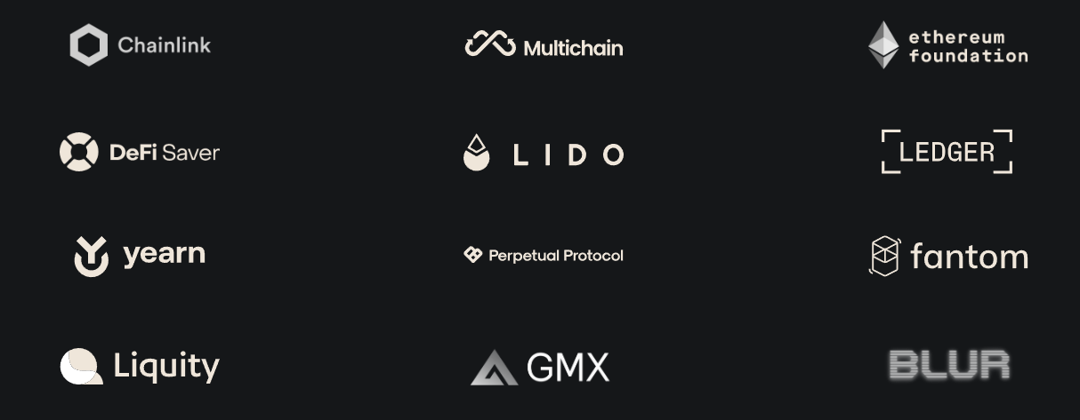

Slide 3
Scope of the study
Ethereum EIPs 6466, 6404 propose migrating receipts root and transactions root from RLP to SSZ
Determine the impact of this change
  Via Multiple Approaches (for completeness)
    Decentralized Bridges?
    Historical Blockchain Events Oracle?
Find & examine affected projects
  What is the provenance of RLP-encoded data? L2? L1? Other?
  Is there a centralized relay that can translate data
  Recently used, high balance, part of a known protocol
If affected, explore upgradeability options

Slide 4
Block Header and Proposed EIP impacts
Field | Description
parent_hash | hash of the parent block
fee_recipient | account address for paying transaction fees to
state_root | root hash for the global state after applying changes in this block
transactions_root | hash of the root of Merkle trie containing txs
receipts_root | hash of the root of Merkle trie containing tx receipts
logs_bloom | data structure containing event logs
prev_randao | value used in random validator selection
block_number | the number of the current block
gas_limit | maximum gas allowed in this block
gas_used | the actual amount of gas used in this block
timestamp | the block time
extra_data | arbitrary additional data as raw bytes
base_fee_per_gas | the base fee value
block_hash | Hash of execution block
Not Impacted
RLP -> SSZ
(EIP-6466)
RLP -> SSZ
(EIP-6404)

Slide 5
Summary of Impact - Mainstream protocols
Project Name | Website | Estimated Impact
zkBridge | zkbridge.com | Moderate
LayerZero |  | Moderate
Telepathy |  | Moderate
Notes:
Most contracts upgradeable, some caveats
Only EIP-6466 (Receipts Root EIP) had an impact
Estimated Impact is subjective
Subjectivity:
- How easy to upgrade?
- How often is it used?
- Alternative configurations
- etc.
What about bridges from L2 to L1? E.g., Polygon, Optimism
=> Out of scope - L2 chains don’t need to opt in to EIPs

Slide 6
Approach 1 - via Static Analysis
Goal - Identify protocols that have recently interacted with “RLP-decoder” algos
By only analysing contract bytecode (statically)
Problem: How do we mechanize an analysis for identifying RLP-decoders?
=> RLP libraries contain a set of consistent comparisons of program variables with constants 0x80, 0xb8, 0xc0 and 0xf8. These are part of the logic for decoding RLP data as specified in the RLP specification.
Problem 2: EVM bytecode does not have “variables”

Slide 7
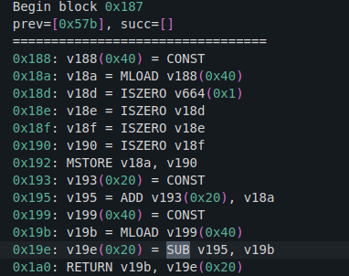
Static Analysis of Decompiled Bytecode
Analysis performed on binary lifted 3-address code from Contract Library full dataset.
select md5_bytecode from decompiled_code
where decompiled_code.tac_level similar to [variable] = [variable] < 0x80
and decompiled_code.tac_level similar to [variable] = [variable] < 0xb8
and decompiled_code.tac_level similar to [variable] = [variable] < 0xc0
and decompiled_code.tac_level similar to [variable] = [variable] < 0xf8
Note:
Actual query had more cases
Code was normalized & simplified
Binary-lifted 3-address code

Slide 8
Approach 2 - via Dynamic Analysis
Goal - Identify contracts & functions that have received RLP-encoded data as part of their arguments.
How do we do this reliably?
(Assuming RLP-encoded data is of type bytes)

Slide 9
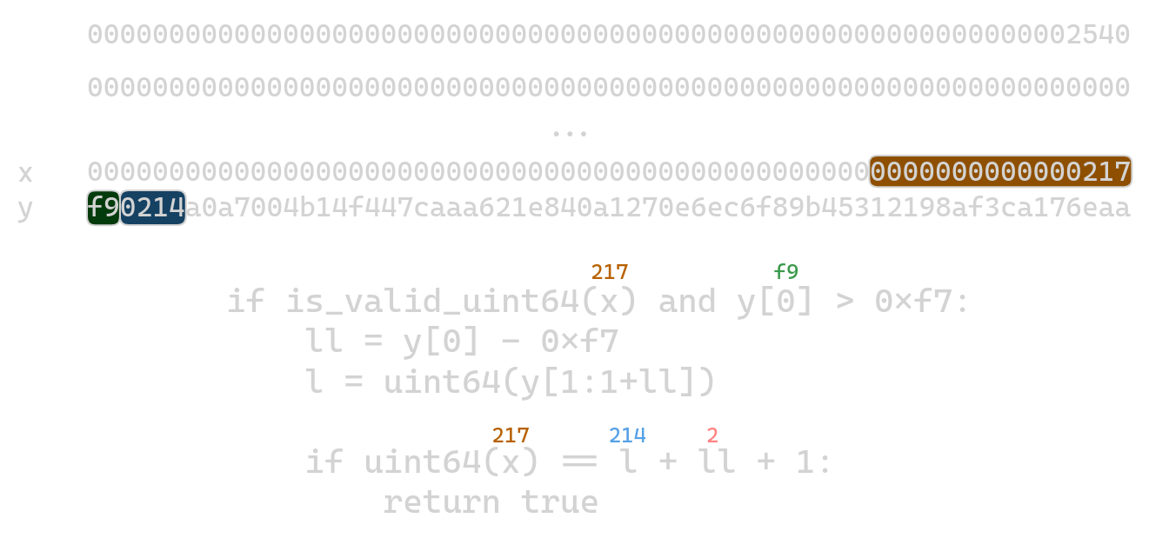
Exploiting “Synchronized” ABI & RLP-Encoding Lengths

Slide 10
Results
Approaches 1 and 2 yielded mostly common contracts
Most popular contracts out of these inspected
Many contracts & protocols flagged. Most unaffected, since the protocol:
doesn’t really perform MPT proofs over RLP-encoded data (false positive)
performs receipts/transaction root MPT inclusion proofs, but only for other chain data (L2s, side-chains)*
performs proofs against MPT commitments that are unrelated to in-scope EIPs (e.g., custom structures, state root) or has some entirely different proof mechanism over RLP-encoded data

Slide 11
Important unaffected protocols
Provenance of RLP data is non-L1
Polygon Bridge
Optimism Bridge
Bittorrent Bridge
Symmetric path (code that verifies L1 data on other chains) not found for these.
Telepathy is capable of storage root-based transaction inclusion proofs which shouldn’t be affected.

Slide 12
Affected Protocols
Layer Zero - MPT proof verification using receipts root. Example here
zkBridge - the protocol is integrated into LayerZero as an Oracle that users can configure in LayerZero’s UltraLightNode
Telepathy - Very complex path!

Slide 13
Conclusion
Impact is moderate, but upgradeability possibilities exist in all cases we found
RLP-decoding w/ MPT proving happens a lot! But most instances unaffected
LayerZero: The default inclusion proof library can be updated to reflect the new SSZ commitment for the receipts root
zkBridge: zkBridge can either wait for LayerZero to address this, or implement their own proof validator and prompt client applications to update their LayerZero configuration
Telepathy: Upgrading the inclusion proof logic should suffice
Full report Twitter: @dedaub Web: dedaub.com

